Slide 1

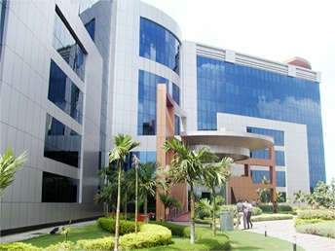
V
Introduction SAP UI5
Thank you
November 2016
Vijay Kalluri(482004)

Slide 2
Agenda
JavaScript Coding Guidelines
SAPUI5 Control Development Guidelines
Model View Controller (MVC)
SAP UI5 - Control Libraries
SAP UI5 - Key Components
SAP UI5 Tool: Eclipse Vs WEBIDE
Security Information for SAPUI5
© 2016, Cognizant Technology Solutions. Vijay Kalluri(482004)

Slide 3
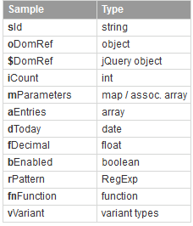
JavaScript Coding Guidelines
Code Formatting
  For any code becoming part of SAPUI5 we need to follow below points
  Add a semicolon after each statement, even if optional
  No spaces before and after round braces (function calls, function parameters)
  use spaces after if/else/for/while/do/switch/try/catch/finally, around curly braces, around operators and after commas
  Opening curly brace (functions, for, if-else, switch) is on the same line
  Use Equals("===“) and not equals ("!==“) instead of "==" and "!=";
Naming Conventions
© 2016, Cognizant Technology Solutions. Vijay Kalluri(482004)

Slide 4
SAPUI5 Control Development Guidelines
Yesterday I told whenever we develop any UI5 application we are going reuse standard template code for Controls for Example: Table/Input etc…
So Reuse the UI control is Good. But carefully compare how many features of the reused control are needed in Our UI5 application. It will be impact on performance.
Whenever developers developing SAPUI5 controls should follow the guidelines i.e. APIs, behavior, and themes/CSS.
API
Get the right API in first time
Control names start with an uppercase letter for Exp: OnPress.
Property, event, aggregation, association, method, and parameter names start with a lowercase letter for Exp: onPress.
Properties, associations, and aggregations should be preferred over API methods due to data binding support and easier usage in XMLViews.
Behavior
For behavior-related development, the following guidelines apply:
Use the SAPUI5 event handling methods when available instead of jQuery.bind()/.on(). When you use jQuery.bind() or jQuery.on(), always unbind them again, for example in onBeforeRendering() and in exit() and rebind after rendering.
Control can be used multiple times in a page.
If an action takes a longer period of time, visualize this, for example by using a BusyIndicator
© 2016, Cognizant Technology Solutions. Vijay Kalluri(482004)

Slide 5
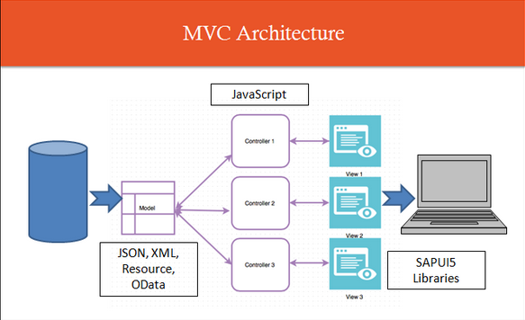
Model View Controller (MVC)
In Model-View-Controller ( MVC ) Architecture
Model:
Is a class which is responsible to
  Hold/Supply data to the application
  Has methods or functions by which we can play around or perform operations on that data.
© 2016, Cognizant Technology Solutions. Vijay Kalluri(482004)

Slide 6
Model View Controller (MVC)
View :
is the part of the application which renders on to the presentation layer and
Controller:
is the code which controls the View’s behavior and its communication to the Model.
In SAPUI5
Model is implemented using one of the 4 classes
  JSONModel
  XML Model
  Resource Model
  OData Model
View is implemented using UI5 Libraries particularly as
  JavaScript View
  XML View
  JSON View
  HTML View
Controller is implemented using JavaScript. The Controller class provides 4 hook methods to control the behavior of the Application
  onInit()--- If view is instantiated then this method will be called.
  onExit() ---- If view is destroyed then this method will be called
  onAfterRendering()---- (the HTML is injected into the document) Fired when the view has been rendered
  onBeforeRendering()---
    Fired before the view is rendered
    Not before the first rendering though, then onInit is called
© 2016, Cognizant Technology Solutions. Vijay Kalluri(482004)

Slide 7
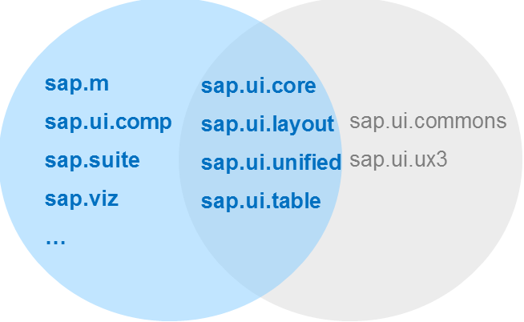
SAP UI5 - Control Libraries
There are various JavaScript and CSS libraries that you can use in combination for the application development. SAPUI5 can use these libraries in combination and they are called SAPUI5 control libraries.
© 2016, Cognizant Technology Solutions. Vijay Kalluri(482004)

Slide 8
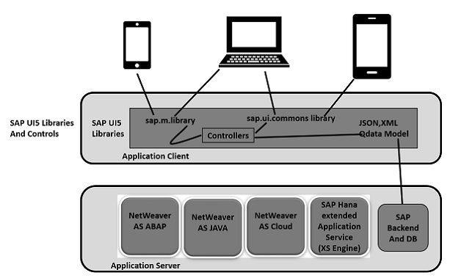
SAP UI5 Libraries
The following table shows the main SAPUI5 control libraries and their description
sap.ui.commons | Common library for standard controls Sap.ui.commons for control fields, buttons, etc.
sap.m | sap.m is the most common control library and is used for mobile devices
sap.makit | SAPUI5 library contains the markit charts.
sap.ui.ux3 | SAPUI5 library with controls that implement the SAP User Experience(UX) Guidelines 3.0
sap.viz | SAPUI5 library containing chart controls based on the VIZ charting library.
© 2016, Cognizant Technology Solutions. Vijay Kalluri(482004)

Slide 9
SAP UI5 - Key Components
SAP UI5 has multiple components which are Components are independent and reusable parts used in SAPUI5 applications.
SAPUI5 provides two types of components:
Faceless components:
Faceless components are used to get the data from the backend system and they don’t contain a user interface.
Example− They are a part of class “sap.ui.core.component”
UI Components
UI components are used to add rendering functionality and represent a screen area or element on the user interface.
Example − UI component can be a button with settings to perform some task.
It is a part of class: sap.ui.core.UIComponent
Note − sap.ui.core.component is the base class(Parent Class) for faceless and UI components. To define the extensibility function, the components can inherit from the base class or from other components in UI development.
© 2016, Cognizant Technology Solutions. Vijay Kalluri(482004)

Slide 10
SAP UI5 Tool: Eclipse Vs WEBIDE
Using both we can develop the UI5 application. I found below some difference between Eclipse Vs WEBIDE.
WEB IDE | Eclipse
WEB IDE will be generated some code automatically when we create UI5 application | Whereas need to implement End-to-End code. Not generated automatically
WEBIDE is not free. Its licensed version | Eclipse is Open Source(free)
Whenever we create application WEBIDE. Its will ask service name(SAP NWGS). If you give proper service it will bind to UI elements and data will be populated. Later whatever you can change accordingly. | Whereas Eclipse we need to write End-to-End Code for get the Model Service.
WEBIDE have drag and drop the UI controls . | Whereas eclipse doesn’t have the option. We need to implement code for UI controls
It seems through WEB IDE. It not possible to deploy the application into the Non SAP System. We can deploy the application only SAP System. | Whereas Eclipse we can deploy both(SAPP & Non SAP) systems also.
WEBIDE- we can access through Internet(Its URL) using SMP credentials | Whereas Eclipse is Software we can install our local system.
© 2016, Cognizant Technology Solutions. Vijay Kalluri(482004)

Slide 11
Security Information for SAPUI5
SAPUI5 is a client-side JavaScript library, so while the library itself is designed and tested to be secure
Browser Security
Transport Security
Server Security
Refer: https://sapui5.hana.ondemand.com/#docs/guide/91f3d8706f4d1014b6dd926db0e91070.html
© 2016, Cognizant Technology Solutions. Vijay Kalluri(482004)

Slide 12

Question & Answers

Slide 13
Thank You

